Slide 1

WiMAX: A standard designed for long-range wireless broadband access
Presented by
Name : Shafinaj Jerin Asha
ID : IT-21031
Course Title : Wireless Communication

Slide 2
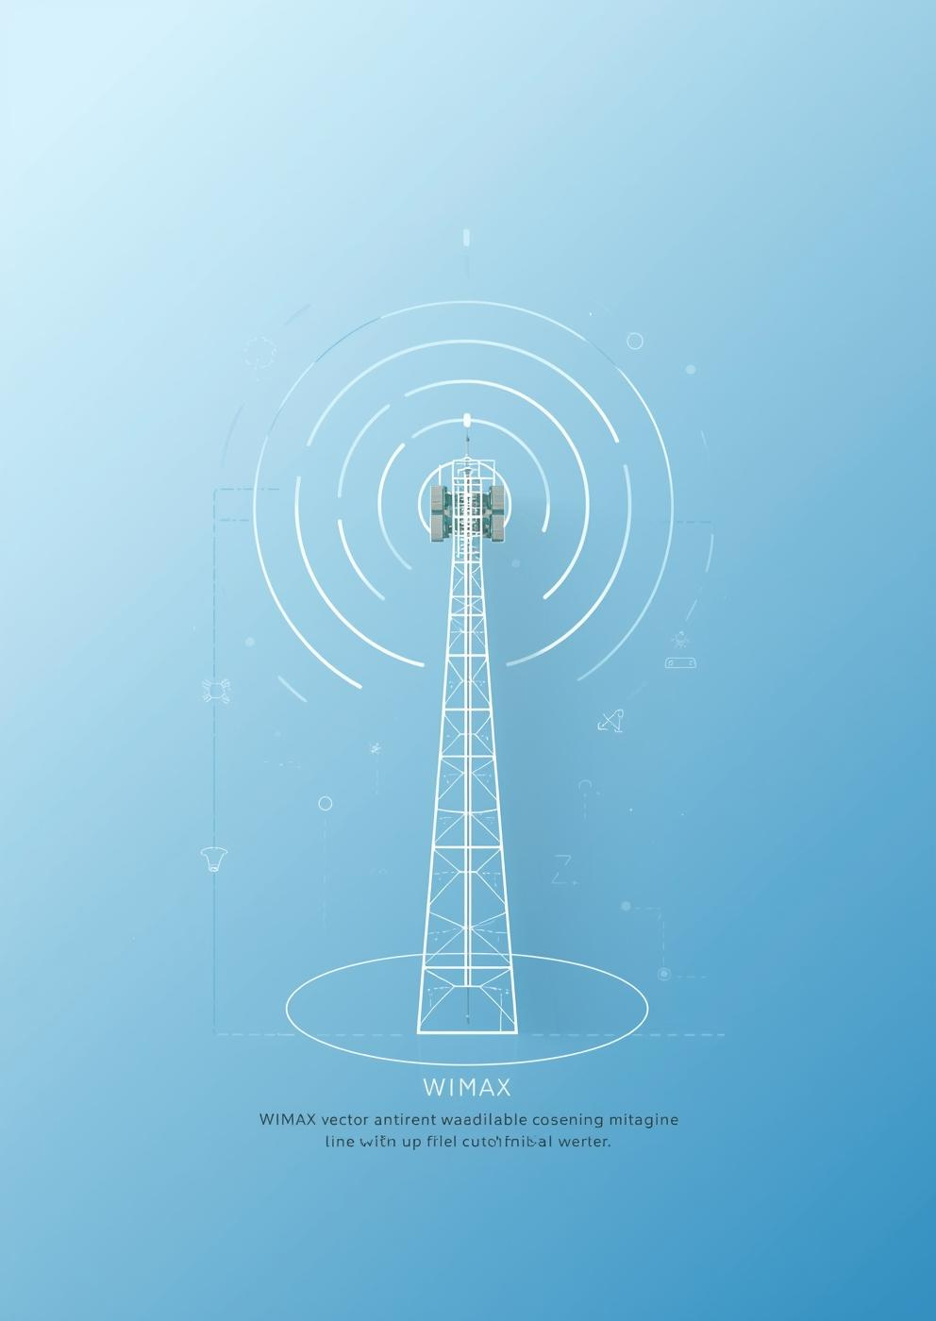
Introduction
Introducing John Doe, WiMAX Expert and Educator
A passionate advocate for wireless technology and its impact on connectivity and education
John brings over 10 years of experience in telecommunications, specializing in wireless technologies and their applications in modern society.
2

Slide 3
WiMAX Evolution
2005 IEEE Standard
2009 First Deployment
2018 Global Adoption
2001 Launch
WiMAX was officially launched, enabling broadband access.
IEEE standardized WiMAX under the 802.16 protocol.
The first WiMAX networks were deployed commercially worldwide.
WiMAX saw increased global adoption across multiple regions.
3

Slide 4
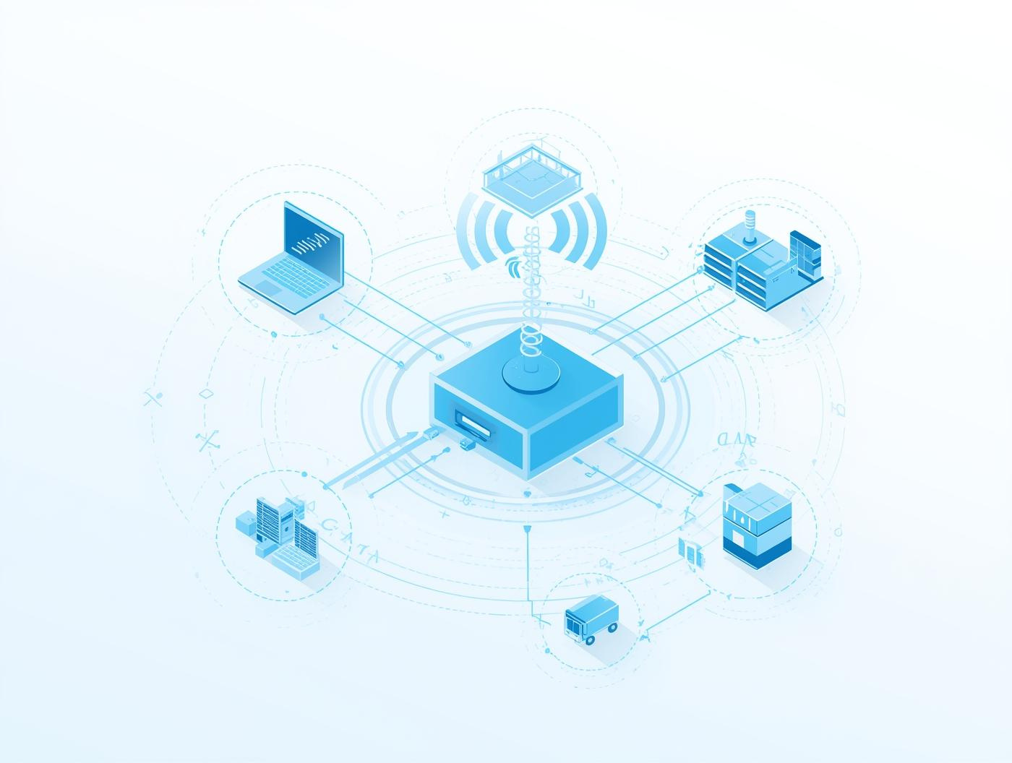
Overview of WiMAX Architecture
Architecture
WiMAX architecture supports high-speed broadband access across distances.
4

Slide 5
How WiMAX Works
Understanding the Key Principles of WiMAX
Signal Transmission
Modulation Techniques
Network Infrastructure
WiMAX utilizes advanced signal transmission techniques to deliver high-speed broadband access over large distances, ensuring reliable connectivity in various environments, including urban and rural settings.
The technology employs modulation techniques such as OFDM (Orthogonal Frequency Division Multiplexing) to efficiently manage bandwidth and improve data throughput, enabling multiple users to connect seamlessly.
WiMAX relies on a robust network infrastructure that includes base stations and subscriber units, facilitating a comprehensive network that supports both fixed and mobile broadband applications.
5

Slide 6

WiMAX Spectrum Management
Frequency Bands
Bandwidth Allocation
WiMAX utilizes multiple frequency bands for various applications.
Efficient bandwidth allocation enhances overall network performance.
Licensing
Interference Mitigation
WiMAX operates under licensed and unlicensed spectrum agreements.
Effective strategies reduce interference and improve connectivity.
6

Slide 7

Key Features of WiMAX
High Speed
Long Range
Scalability
WiMAX provides broadband access at impressive speeds worldwide.
It enables connectivity over long distances with minimal loss.
WiMAX networks can scale efficiently to meet growing demands.
Flexibility
Interoperability
The technology supports various deployment scenarios and configurations.
WiMAX is designed to work seamlessly with multiple devices.
7

Slide 8
Advantages of WiMAX
Key Benefits of Wireless Connectivity Technology
High-Speed Access
Cost-Effective Solutions
Wide Coverage
WiMAX provides high-speed broadband connectivity over long distances, facilitating seamless internet access even in remote areas, which is crucial for bridging the digital divide.
By utilizing existing infrastructure and reducing deployment costs, WiMAX offers affordable connectivity options for both consumers and businesses, making advanced telecommunications more accessible.
The technology is designed to cover extensive areas, providing broad network coverage that supports numerous users simultaneously, enhancing the overall efficiency of wireless communications.
8

Slide 9


WiMAX Compared to Other Technologies
WiMAX
LTE
Offers high-speed, long-distance broadband access efficiently.
Provides faster speeds but with limited coverage options.
9

Slide 10



WiMAX Applications in Everyday Life
Connectivity
Expansion
Education
WiMAX enables seamless internet access in cities.
It brings broadband to remote and rural areas.
WiMAX facilitates learning through online resources.
10

Slide 11

The Future of WiMAX Technology Innovations
Innovations
WiMAX technology is evolving to meet future demands.
11

Slide 12
Scalability in WiMAX
Network Expansion
Resource Allocation
User Capacity
WiMAX networks can efficiently grow with increasing user demands.
Dynamic resource allocation allows for optimal bandwidth distribution.
WiMAX supports a large number of simultaneous users seamlessly.
Flexible Infrastructure
Future-Proofing
The infrastructure can adapt to varying geographic requirements easily.
WiMAX technology is designed to evolve with emerging needs.
12

Slide 13
Mobility in WiMAX
Connectivity
Coverage
Performance
WiMAX provides strong connectivity for users on the move.
It offers extensive coverage, supporting diverse urban areas.
Users experience high performance while traveling or commuting.
Flexibility
Convenience
Adaptability
WiMAX allows flexible connections, adapting to user needs.
Seamless convenience enhances user satisfaction and productivity.
The technology ensures adaptability for various devices and settings.
13

Slide 14
Security Measures
Encryption
Authentication
Firewalls
Encryption protects data during transmission and storage processes.
Authentication verifies user identities before granting network access.
Firewalls block unauthorized access to the network's data.
Intrusion Detection
Data Backup
Intrusion detection systems monitor for suspicious network activities.
Regular data backups ensure recovery from potential security breaches.
14

Slide 15
Cost-Effectiveness of WiMAX
Affordability
Reduced Infrastructure
WiMAX provides cost-effective broadband solutions for rural areas.
Deployments require less infrastructure investment compared to traditional methods.
Scalable Solutions
Lower Operational Costs
WiMAX enables scalable solutions to meet growing connectivity demands.
Operating costs are significantly lower, enhancing profitability for providers.
15

Slide 16
Standardization of WiMAX
IEEE 802.16
Compliance Standards
IEEE 802.16 defines WiMAX's operational framework and specifications.
Ensures interoperability and supports diverse vendor equipment connections.
16

Slide 17
Interoperability in WiMAX
Device Compatibility and Standards
Network Integration Challenges
Future of Interoperability
Emphasizes the need for evolving standards and solutions.
Ensures smooth communication among different devices.
Overcoming barriers for seamless connectivity is essential.
17

Slide 18
Quality of Service (QoS)
Prioritizing Network Traffic Efficiency
Reducing Latency for Better Experience
Ensuring Reliability and Stability
QoS manages bandwidth for optimal performance.
Low latency enhances user experience significantly.
Consistent performance is crucial for applications.
18

Slide 19
Range and Coverage
Extensive Reach
Versatile Applications
WiMAX provides broad wireless coverage over large distances effectively.
It supports various use cases in urban and rural settings.
19

Slide 20
Thank You

